Slide 1

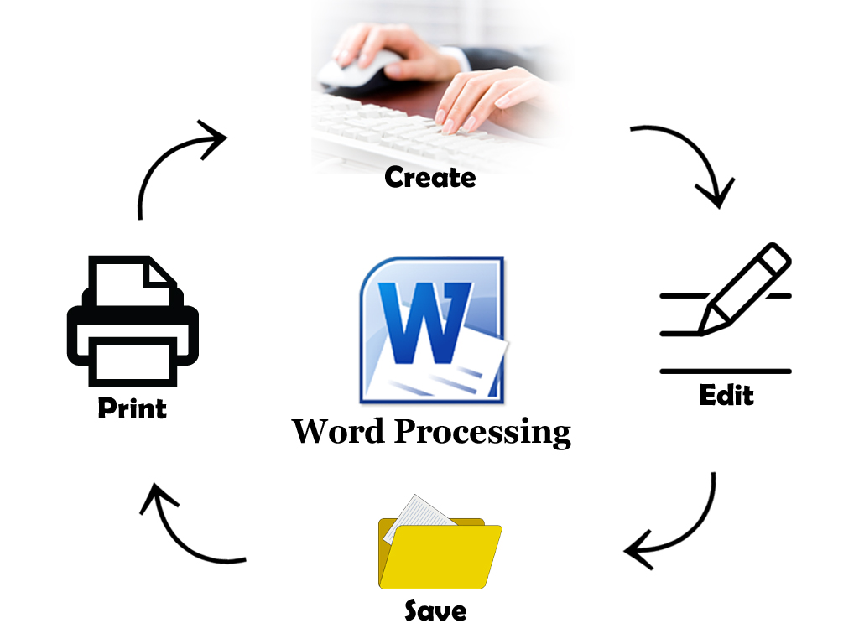


Word
Processing
Class V
lab 17

Slide 2

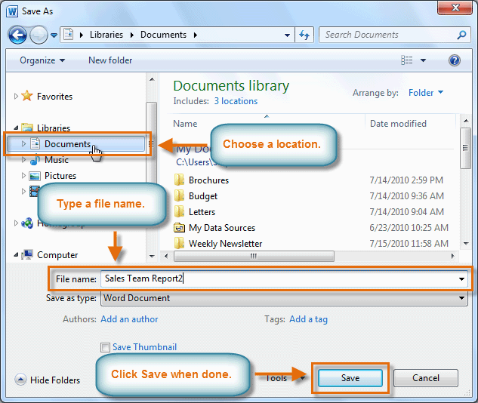
Save as Command
Save As allows you to choose a name and location for your document

Slide 3
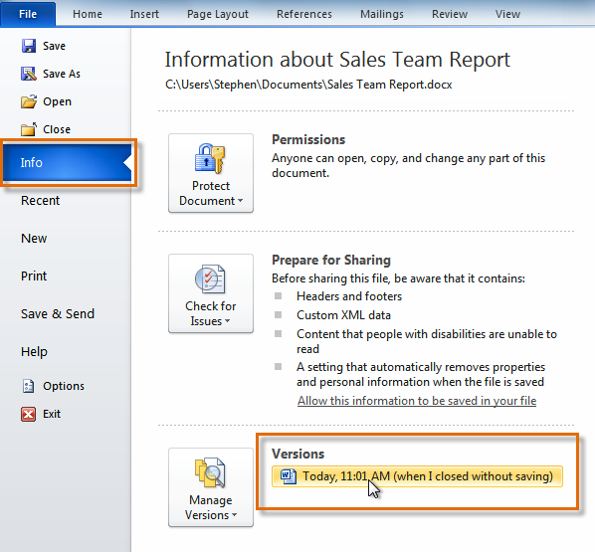
Auto Recover
Word automatically saves your documents to a temporary folder while you're working on them

Slide 4
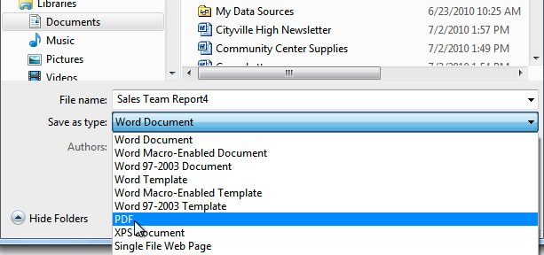
Save as PDF
go to save as and select pdf then save file

Slide 5


